Slide 1
Searching and sorting
BY: Amber Hayat
ahayat@ddn.upes.ac.in

Slide 2
Time Complexity of Algorithms
Time complexity of an algorithm signifies the total time required by the program to run to completion

Slide 3
Calculating Time Complexity
The most common metric for calculating time complexity is Big O notation.
This removes all constant factors so that the running time can be estimated in relation to N, as N approaches infinity. In general you can think of it like this :
statement;
Above we have a single statement. Its Time Complexity will be Constant. The running time of the statement will not change in relation to N.

Slide 4
for(i=0; i < N; i++)
{
statement;
}
The time complexity for the above algorithm will be Linear. The running time of the loop is directly proportional to N

Slide 5
for(i=0; i < N; i++)
{
for(j=0; j < N;j++)
{
statement;
}
}
This time, the time complexity for the above code will be Quadratic. The running time of the two loops is proportional to the square of N. When N doubles, the running time increases by N * N.

Slide 6
while(low <= high)
{
mid = (low + high) / 2;
if (target < list[mid])
high = mid - 1;
else if (target > list[mid])
low = mid + 1;
else break;
}
This is an algorithm to break a set of numbers into halves, to search a particular field(we will study this in detail later). Now, this algorithm will have a Logarithmic Time Complexity. The running time of the algorithm is proportional to the number of times N can be divided by 2(N is high-low here). This is because the algorithm divides the working area in half with each iteration.

Slide 7
void quicksort(int list[], int left, int right)
{
int pivot = partition(list, left, right);
quicksort(list, left, pivot - 1);
quicksort(list, pivot + 1, right);
}
Taking the previous algorithm forward, above we have a small logic of Quick Sort(we will study this in detail later). Now in Quick Sort, we divide the list into halves every time, but we repeat the iteration N times(where N is the size of list). Hence time complexity will be N*log( N ). The running time consists of N loops (iterative or recursive) that are logarithmic, thus the algorithm is a combination of linear and logarithmic.

Slide 8
Linear Search
The linear search compares each element of the array with the search key until the search key is found.
To determine that a value is not in the array, the program must compare the search key to every element in the array.
It is also called “Sequential Search” because it traverses the data sequentially to locate the element.

Slide 9
Algorithm for Linear Search
Algorithm: (Linear Search)
LINEAR (A, SKEY)
Here A is a Linear Array with N elements and SKEY is a given item
of information to search. This algorithm finds the location of SKEY in
A and if successful, it returns its location otherwise it returns -1 for
unsuccessful.
1. Repeat for i = 0 to N-1
2. if( A[i] = SKEY) return i [Successful Search]
[ End of loop ]
3. return -1 [Un-Successful]
4. Exit.

Slide 10
Binary Search
The binary search algorithm can only be used with sorted array and eliminates one half of the elements in the array being searched after each comparison.
The algorithm locates the middle element of the array and compares it to the search key.
If they are equal, the search key is found and array subscript of that element is returned. Otherwise the problem is reduced to searching one half of the array.
If the search key is less than the middle element of array, the first half of the array is searched.
If the search key is not the middle element of in the specified sub array, the algorithm is repeated on one quarter of the original array.
The search continues until the sub array consist of one element that is equal to the search key (search successful). But if Search-key not found in the array then the value of END of new selected range will be less than the
START of new selected range.

Slide 11
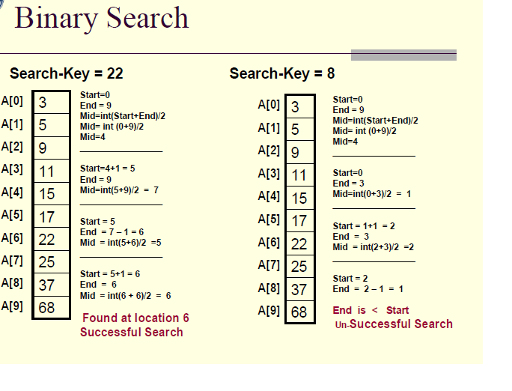

Slide 12
Algorithm: (Binary Search)
Here A is a sorted Linear Array with N elements and SKEY is a given item of information to search. This algorithm finds the location of SKEY in A and if successful, it returns its location otherwise it returns -1 for unsuccessful.
BinarySearch (A, SKEY)
1. [Initialize segment variables.]
Set START=0, END=N-1 and MID=INT((START+END)/2).
2. Repeat Steps 3 and 4 while START ≤ END and A[MID]≠SKEY.
3. If SKEY< A[MID]. Then
Set END=MID-1.
Else Set START=MID+1.
[End of If Structure.]
4. Set MID=INT((START +END)/2).
[End of Step 2 loop.]
5. If A[MID]= SKEY then Set LOC= MID
Else:
Set LOC = -1
[End of IF structure.]
6. return LOC and Exit

Slide 13
Complexity of Binary Search
The Computational Complexity of the Binary Search algorithm is measured by the maximum (worst case) number of Comparisons it performs for searching operations.
The searched array is divided by 2 for each comparison/iteration. Therefore, the maximum number of comparisons is measured by:
log2(n) where n is the size of the array

Slide 14
Complexity of Linear Search
The Computational Complexity of the Linear Search is the maximum number of comparisons you need to search the array.
As you are visiting all the array elements in the worst case, then, the number of comparisons required is:
n (n is the size of the array)

Slide 15
Sorting
Sorting an array is the ordering the array elements in ascending (increasing - from min to max) or descending (decreasing – from max to min) order.
Example:
{2 1 5 7 4 3} to {1, 2, 3, 4, 5,7} ascending order
{2 1 5 7 4 3} to {7,5, 4, 3, 2, 1} descending order

Slide 16
Bubble Sort
The technique we use is called “Bubble Sort” because the bigger value gradually bubbles their way up to the top of array like air bubble rising in water, while the small values sink to the bottom of array.
This technique is to make several passes through the array. On each pass, successive pairs of elements are compared. If a pair is in increasing order (or thevalues are identical), we leave the values as they are. If a pair is in decreasing order,their values are swapped in the array.

Slide 17
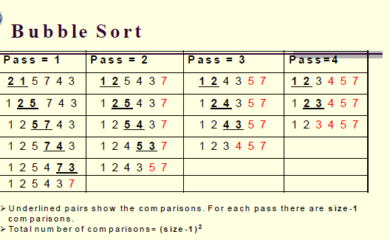

Slide 18
Algorithm for Bubble Sort
Algorithm: (Bubble Sort) BUBBLE (DATA, N)
Here DATA is an Array with N elements. This algorithm sorts the elements in DATA.
1. for pass=1 to N-1.
2. for (i=0; i<= N-Pass; i++)
3. If DATA[i]>DATA[i+1], then:
Interchange DATA[i] and DATA[i+1].
[End of If Structure.]
[End of inner loop.]
[End of Step 1 outer loop.]
4. Exit.

Slide 19
Selection sort
Suppose an array A with N elements A[0], A[1], . . . A[N-1] Is in memory.
The Selection sort algorithm for sorting A works as follows.
First find the smallest element in the list and put it in the first position. Then find the second smallest element in the list and put it the second position. And so on.

Slide 20
Pass 1: Find the location LOC of the smallest in the list of N elements A[0], A[1], .. . . . A[N-1], and then interchange A[LOC] and A[0]. Then: A[0] is sorted.
Pass 2: Find the location LOC of the smallest in the sublist of N-1 elements A[1], A[2], . . . A[N-1], and interchange A[LOC] and A[1]. Then: A[0], A[1] is sorted. Since A[0] ≤ A[1].
. . . . . . . . . . . . . . . . . . . . . . . . . . . . . . . . . . . . . . . . . . . . . . . . . . . . . . . . . . . .
. . . . . . . . . . . . . . . . . . . . . . . . . . . . . . . . . . . . . . . . . . . . . . . . . . . . . . . . . . . .
Pass N-1: Find the location LOC of the smallest A[N-2] and A[N-1], and then interchanged A[LOC] and A[N-1]. Then: A[0], A[1], A[2], . . . . A[N-1] is sorted.

Slide 21
Algorithm
MIN(A, K, N, LOC)
[An Array A is in memory. This procedure finds the location Loc of the smallest element among A[K], A[K+1], . . . . .A[N-1].]
1. Set MIN = A[K] and LOC = K. [Initializes pointers.]
2. Repeat for J=K+1, K+2, . . . . . N:
If MIN > A[J], then: MIN = A[J] and LOC = J.
3. Return LOC.
(SELECTION SORT) SELECTION (A, N)
1. Repeat steps 2 and 3 for K=0,1,2, . . . . . N-2:
2. Call MIN(A, K, N, LOC).
3. [Interchange A[K] and A[LOC].]
Set TEMP = A[K], A[K] = A[LOC] and A[LOC] = TEMP.
[End of step 1 loop.]
4. Exit.

Slide 22
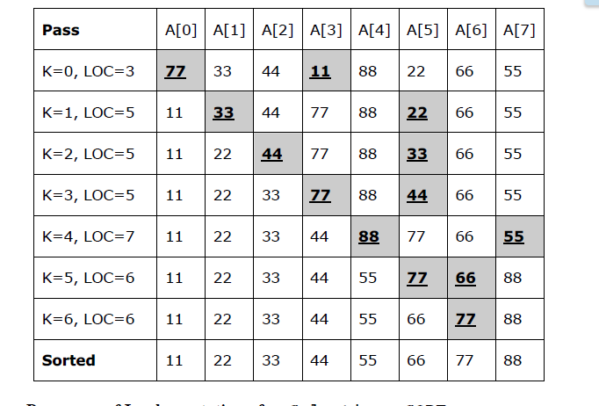

Slide 23
Insertion Sort
Suppose an array A with N elements A[0], A[1], . . . . A[N-1] is in memory.
The insertion sort algorithm scan A from A[0] to A[N-1], inserting each element A[K] into its proper position in the previously sorting sub array A[0], A[1], . . . .A[K-1].

Slide 24
Pass 1: A[1] is inserted either before of after A[0] so that: A[0], A[1] is sorted.
Pass 2: A[2] is inserted into its proper place in A[0], A[1], so that A[0], A[1], A[2]
are sorted.
Pass 3: A[3] is inserted into its proper place in A[0], A[1], A[2] so that: A[0], A[1],
A[2], A[3] are sorted.
. . . . . . . . . . . . . . . . . . . . . . . . . . . . . . . . . . . . . . . . . . . . . . . . . . . . . . . . . . . .
Pass N-1: A[N-1] is inserted into its proper place in A[0], A[1], . . . . . A[N-1] so
that: A[0], A[1], . . . . A[N-1] are sorted. This sorting algorithm is frequently used when N is small. There remains only the problem of deciding how to insert A[K] in its proper place in the subarray A[0], A[1], . . . . A[K-1].
This can be accomplished by comparing A[K] with A[K-1], comparing A[K] with A[K-2], comparing A[K] with A[K-3], and so on, until first meeting an element A[i] (where i start from k-1) such that A[i] ≤ A[K]. then each of elements A[K-1], A[K-2], . . . . A[i+1] is moved forward one location, and A[K] is then
inserted in the i+1 st position in the array.

Slide 25
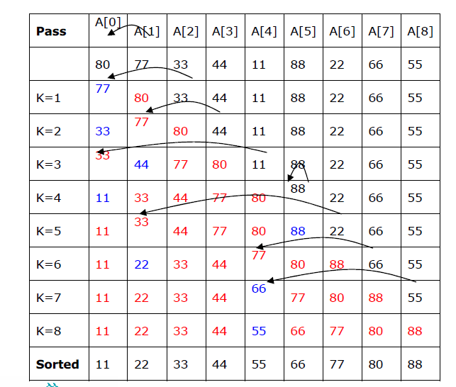

Slide 26
Algorithm: (INSERTION SORT) INSERTION (A, N)
[ Where A is an array and N is the Size of values in the array]
1. Repeat steps 2 to 4 for K=1,2,3, . . . . . N-1:
2. Set TEMP = A[K] and i =K-1.
3. Repeat while i >= 0 and TEMP < A[i]
a) Set A[i+1] = A[i]. [Moves element forward.]
b) Set i = i -1.
[End of loop.]
4. Set A[i+1] =TEMP. [Insert element in proper place.]
[End of Step 2 loop.]
5 Return.

Slide 27
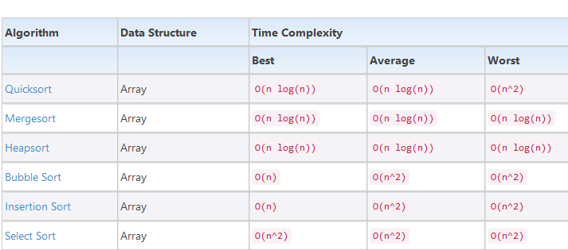
Time Complexity of different sorting algorithms

